Slide 1
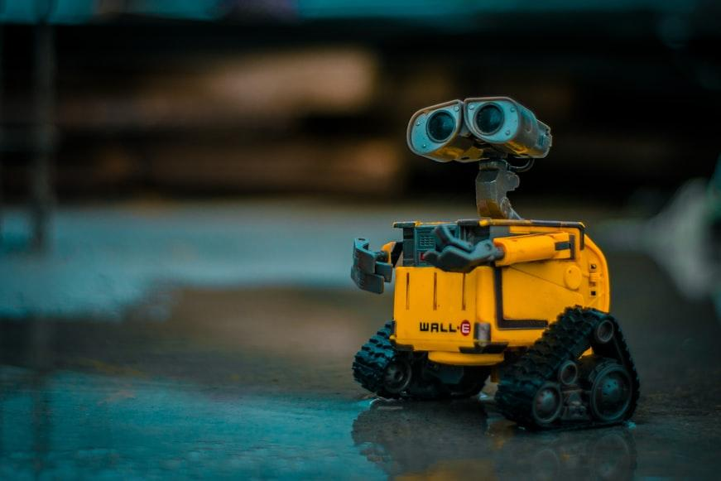
MOBILE ROBOT NAVIGATION USING ROS
Project Members:
Pranto Abir Shahriar
Yousha Mohammed Shamin
Das Anjan Kumar
Project Supervisor: Kiss Domokos

Slide 2

INTRODUCTION
Mobile robots and robotic vehicles are becoming more and more widespread in industrial and everyday scenarios as well. These robots have to navigate among obstacles safely while progressing towards their target. The purpose of this project is to investigate and implement path planning and obstacle avoidance algorithms on a small-sized mobile robot.

Slide 3

ROS Tutorials
Installing ROS and setting up the ROS environment on your computer
Creating ros package
Use of roslaunch and rqt_console
Understanding ROS Nodes
Understanding ROS Topics
Basic Concept of Publisher and Subscriber

Slide 4
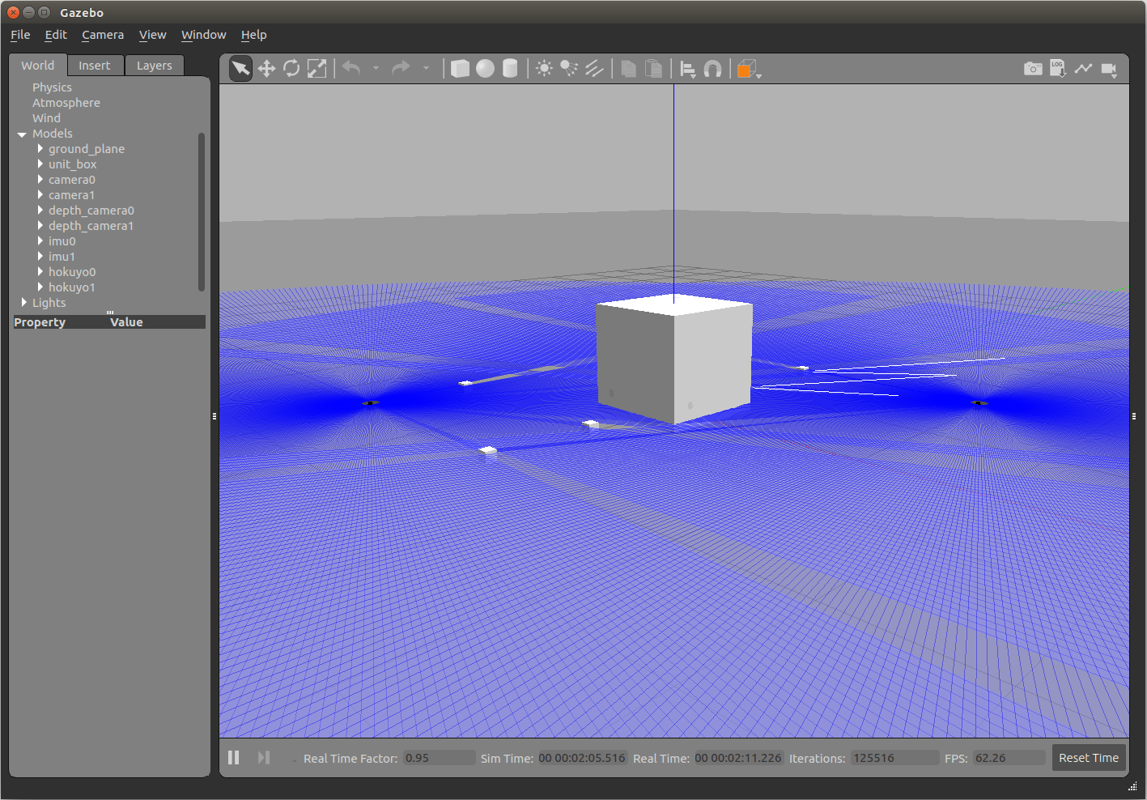
Gazebo Tutorials
Gazebo is an open-source 3D robotics modelling and simulator
Understanding the GUI
Use of the Model Editor
Creating Environment and
Using Plugins
SDF modeling using by constructing a rotating lidar sensor

Slide 5
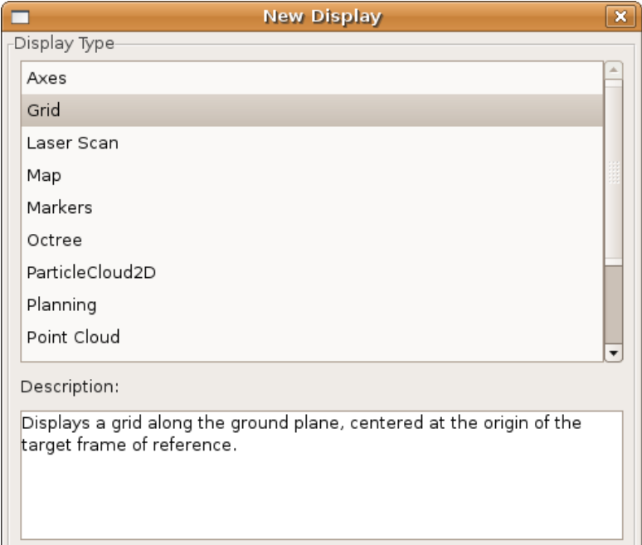
RViz
RViz is a 3D Visualization Environment specifically for robot development. RViz lets us view what the robot is seeing, thinking and doing. There are two main ways to put data in RViz’s world:
RViz understands sensor and state information, like laser scan , cameras, point cloud , coordinate frames
There is visualization markers that allows programmatic addition of various primitive shapes to the 3D view

Slide 6
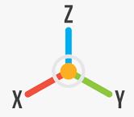
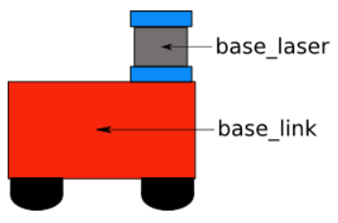
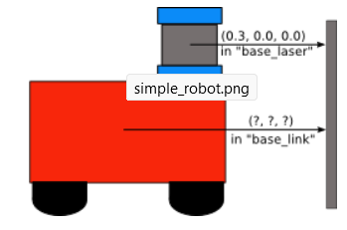
TF
=> In simplest term TF handles the transformation between frames
=> Everything is a Frame

Slide 7
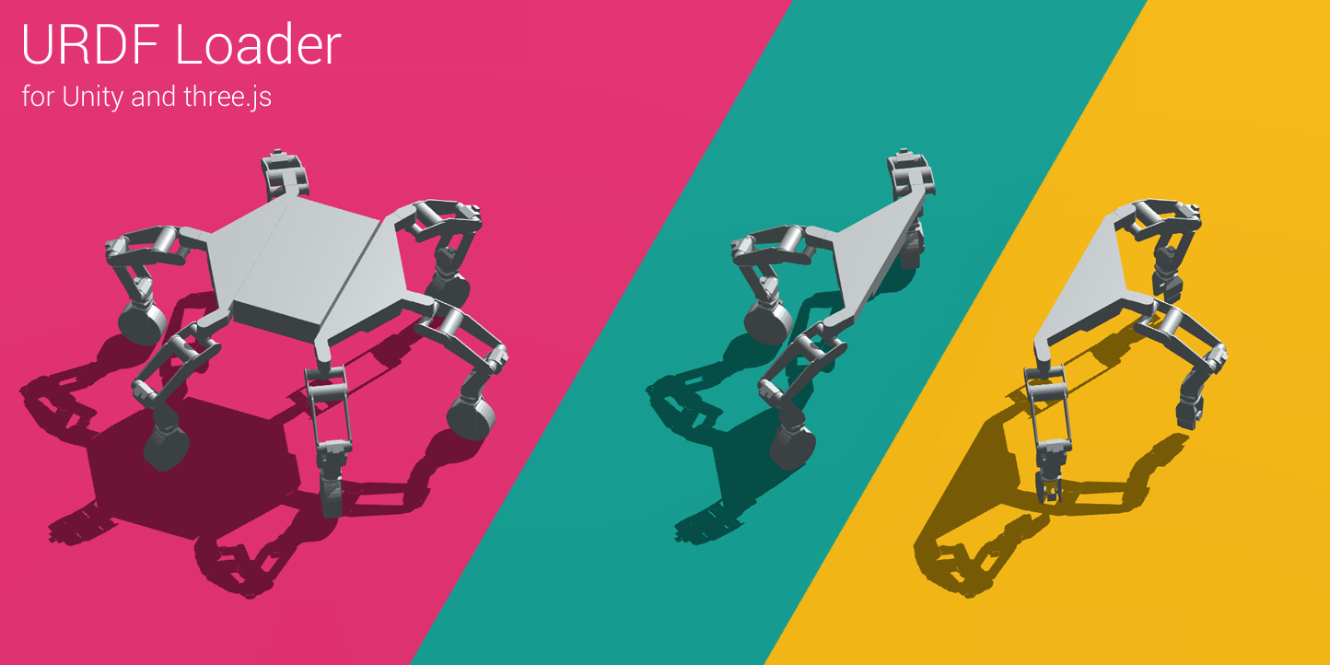
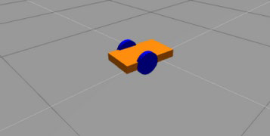
URDF
=> Stands for Unified Robotics Description Format
=> Collection of description that defines a Robot
Advantages:
=> Working with simulation
=> Implement programs before trying on the
real robot

Slide 8

ROS Navigation Stack
=> Navigation is an essential part of robotics, particularly in robot control.
=>ROS navigation package provides us with a 2D navigation stack that takes in information from odometry, sensor streams, and a goal pose and outputs safe velocity commands that are sent to a mobile base.

Slide 9
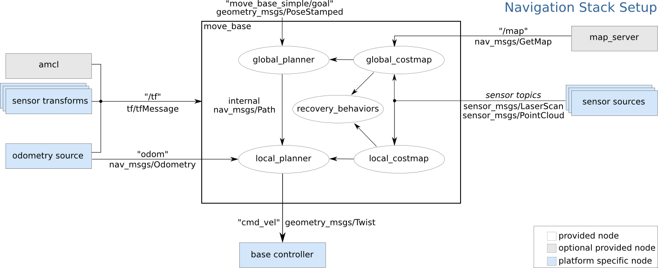
Move_base package within ROS navigation
=> This is the top level view of the move_base within ROS navigation.
=> The box at the center represents the move_base.
=> It takes all the sensor information, odometry ,messages and build all the planning with in it.
=> Finally it publishes the safe driving commands to the robot base.

Slide 10
ROS Actions
=> The actionlib stack provides a standardized interface for interfacing with preemptable tasks.
=> Such as moving the robot base from a target point to goal point, performing laser scan and publishing the result as point cloud.

Slide 11
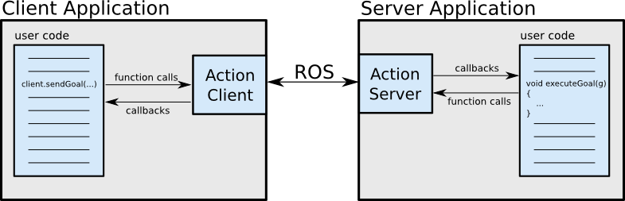
Client Server Interaction within ROS action Library

Slide 12
Client Server Interaction Specifications
The Client Server interaction is done using 3 specifications. They are:
· Goal: The goal is the target task that must be done by the server and which is requested by the client.
· Feedback: Feedback provides server implementers a way to tell an ActionClient about the incremental progress of a goal.
· Result: A result is sent from the ActionServer to the ActionClient upon completion of the goal.

Slide 13

Problem Description
Implement wall following ROS node and maze solving algorithm.
=> Implementation of well known wall follow algorithm as a form of ROS node.
=> Build a random simple connected maze.
=> Implementation of the wall follow node as maze solving algorithm.

Slide 14
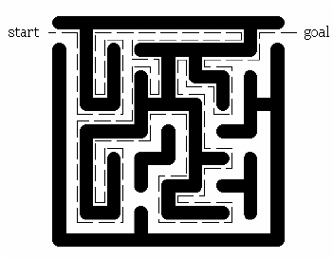
Wall follow Algorithm
The wall-follow algorithm states that for a connected maze, if one keeps its hand fixed on any of the wall and traverse the maze it will finally reach the exit. It is well known algorithm for maze solving.

Slide 15
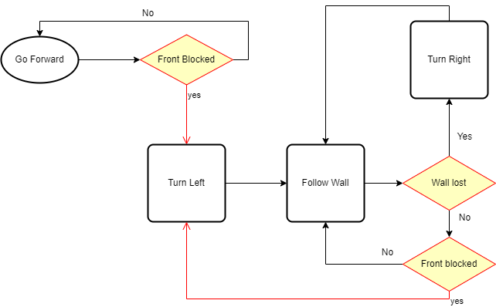
Wall follow Algorithm
Working Flow Chart

Slide 16
=> The robot starts with going forward.
=> If it faces obstacle, it turns left to keep the obstacle on it’s right.
=> Then starts to follow the wall keeping it on it’s right.
=> While following the wall if the wall is lost it turns right to get the wall again.
=> While following the wall if is faces obstacle in front then it turns left to keep the wall on its right.

Slide 17
Working Principle of Wall follow ROS Node
=> The wall follow ROS node gets the laser reading from the sensor by subscribing to the scan topic published by the sensor.
=> The wall follow ROS node communicates with the robot model by publishing the motion command in the cmd_vel topic.
=> In between subscribing and publishing, the ROS node is running the wall follow algorithm. Based on which the node is generating the motion commands.

Slide 18
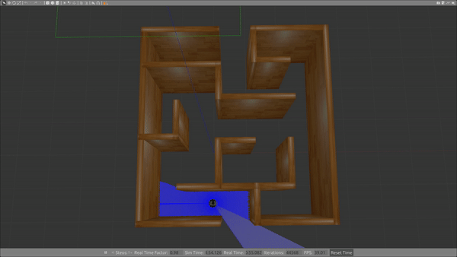
Demonstration
Wall follow in a maze

Slide 19
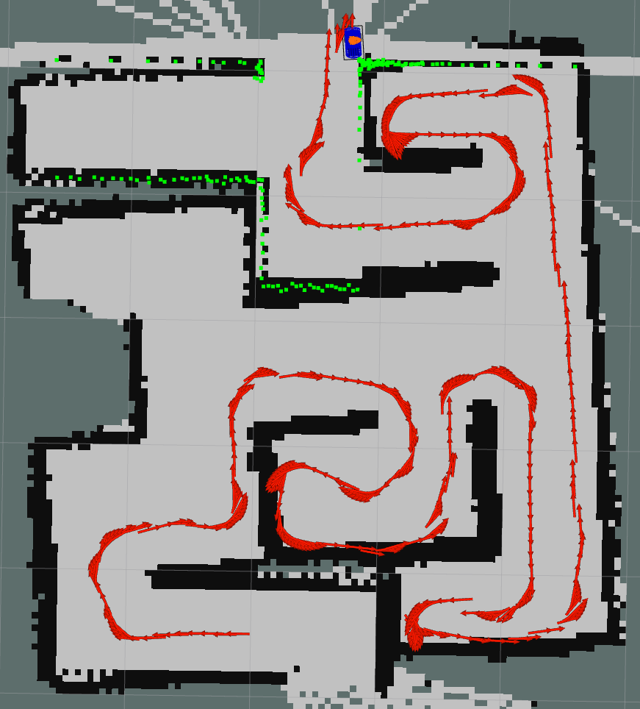
Result
=> The wall follow algorithm could solve the simple connected maze. The solving path can be visualized.

Slide 20

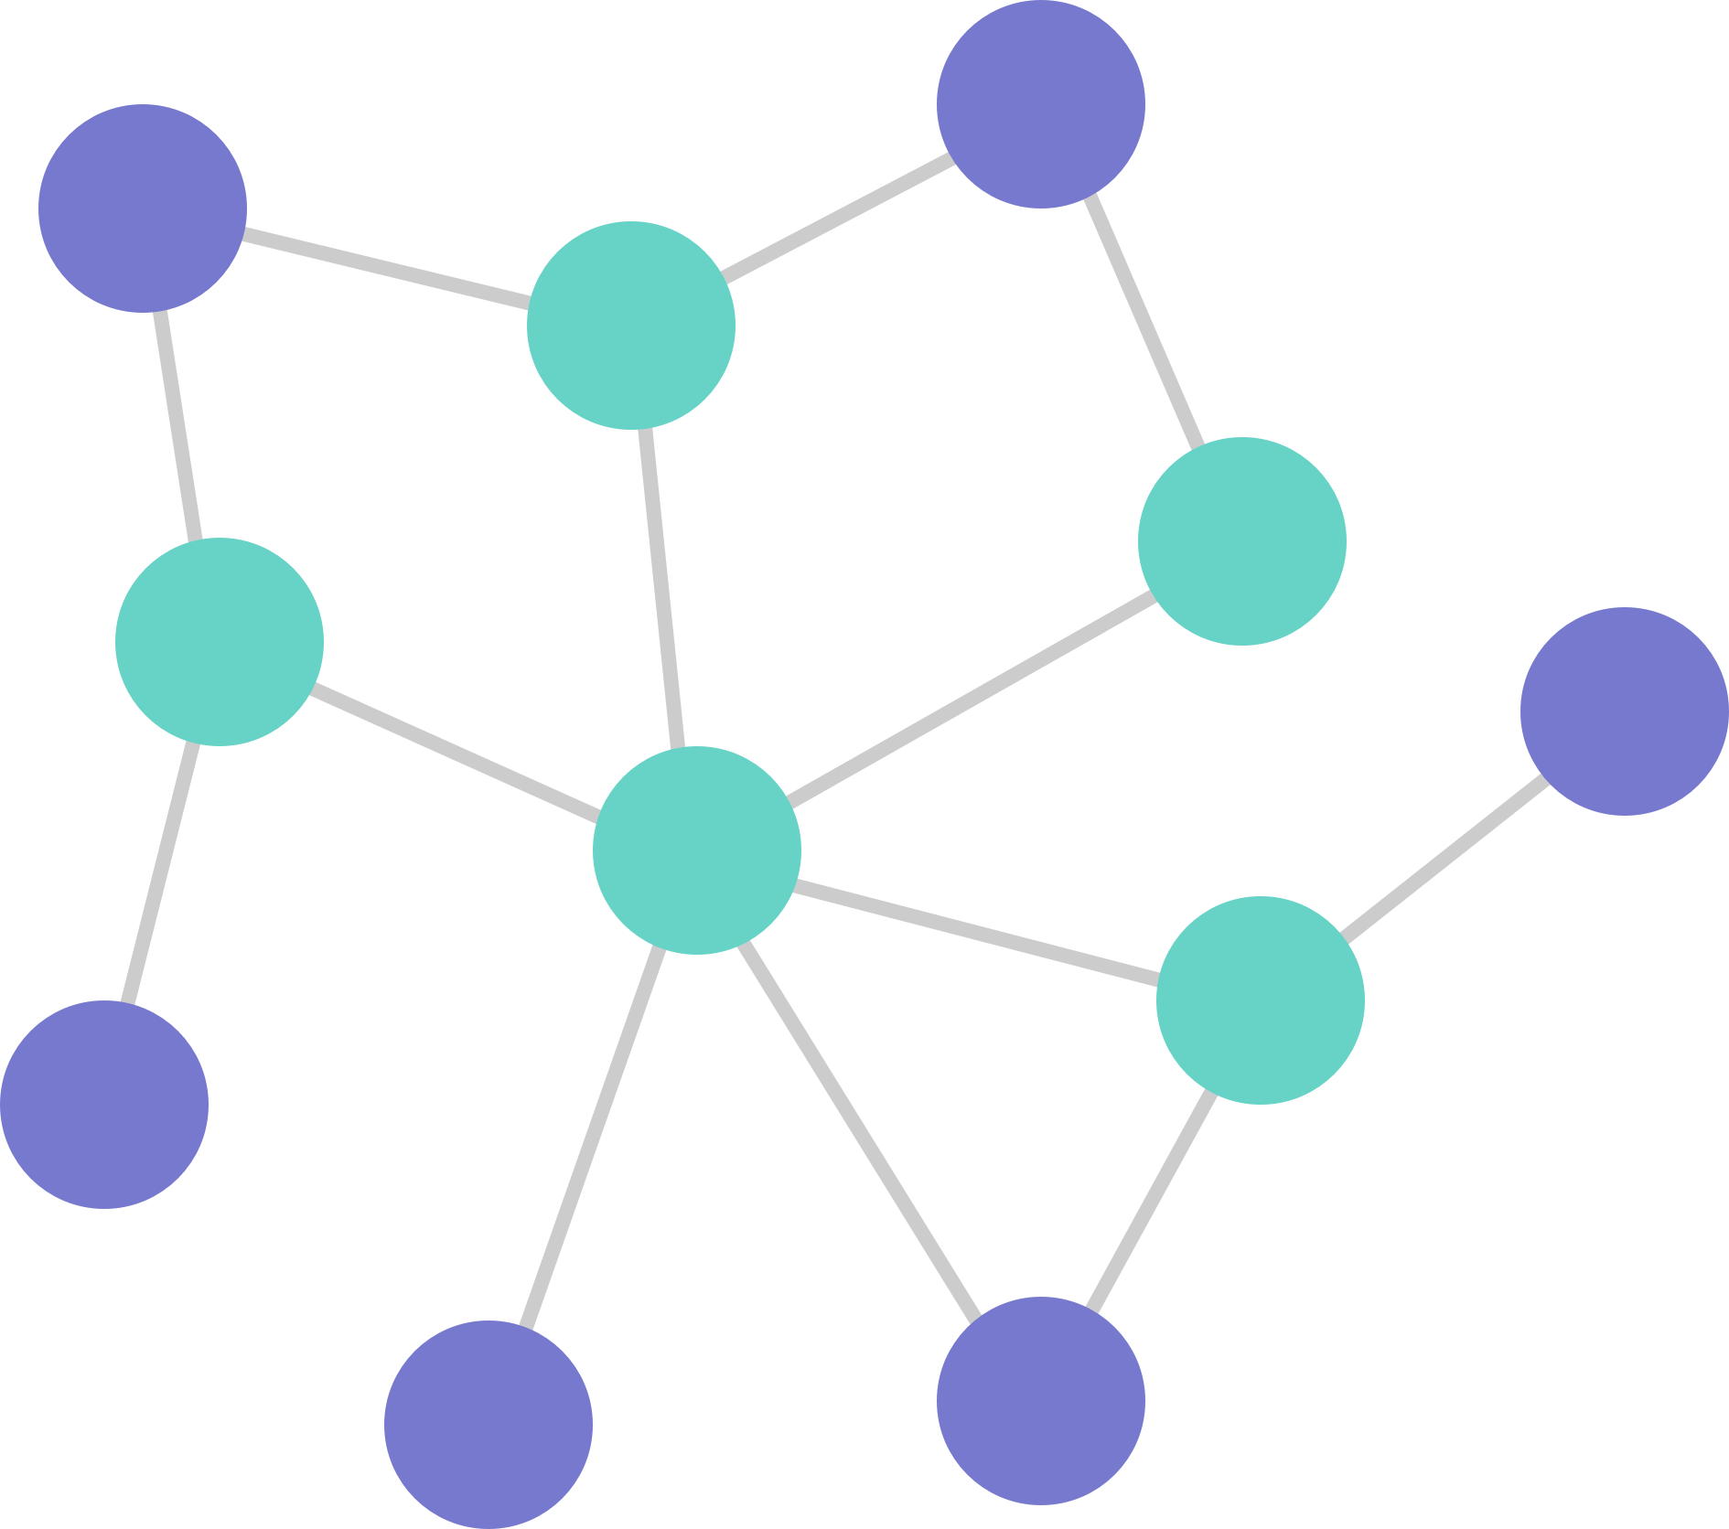

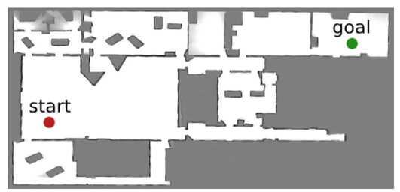
Rapidly-exploring Random Tree
Problem Overlay:

Slide 21
What is RRT?
=> The Idea Began with Random-Tree [random nodes with no consequences or results]
=> New methodology changes how we look at this problem solving
=> Instead of random node, we pick the nearest one and connect
=> Idea is to use as less resources and processing power to reach goal

Slide 22
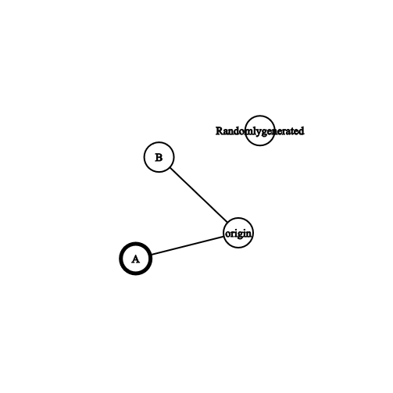
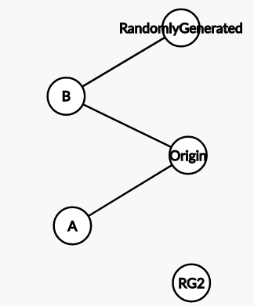
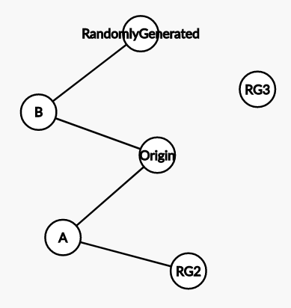
How RRT Expands

Slide 23
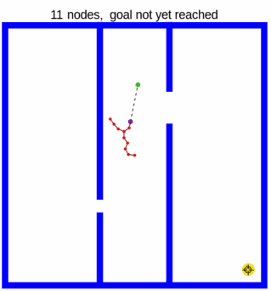
How Does it look like?

Slide 24
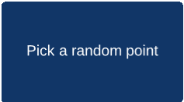
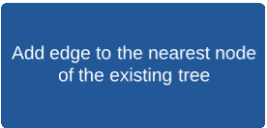

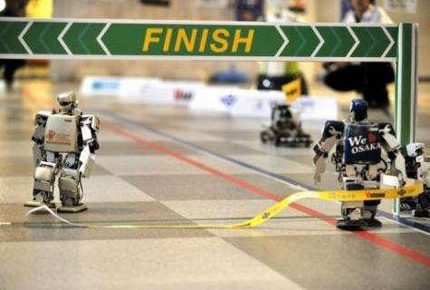
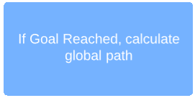
Approach Towards Solving

Slide 25
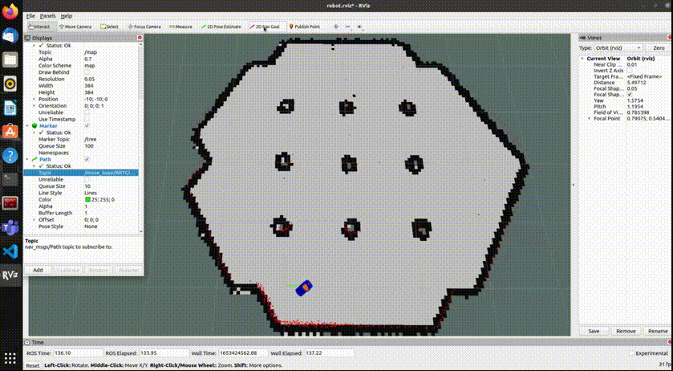
Programming Implementation

Slide 26
VIRTUAL FORCE FIELD ALGORITHM (VFF)
Obstacle avoidance is the ability of determining a collision free path by using the previous analysis of the data sent by different sensors that makes the robot enable to process the information about where the obstacles are located
VFF is a real time obstacle avoidance algorithm which is constructed on the basic principles of virtual force calculation. It is usually a local path planner
It is based on the concept of certainty grid

Slide 27
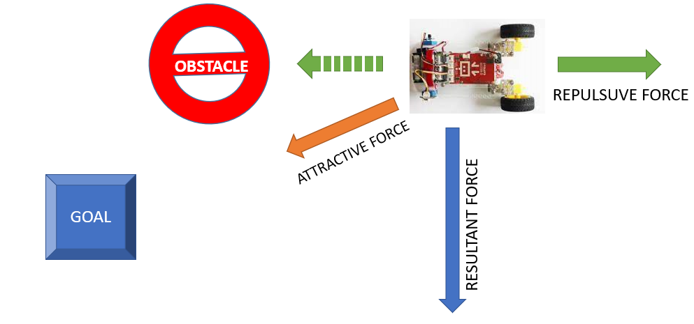
VIRTUAL FORCE FIELD ALGORITHM (VFF)
Brooks’ implementation treats each sensor range reading as a repulsive force vector. If the magnitude of the sum of the repulsive forces exceeds a certain threshold, the robot stops, turns into the direction of the resultant force vector, and moves on.

Slide 28
VIRTUAL FORCE FIELD ALGORITHM (VFF)
Key Steps of Implementation
Understanding and Transform laser measurements to point cloud in the robot frame
Calculate elementary repulsive force components for every obstacle point and find the final repulsive force
Calculating the attractive force according to the goal point
Calculating the resulting virtual force
Calculating the velocity commands based on the resulting virtual force direction
Defining a custom arrow marker in RViz for displaying forces.
Implement VFF algorithm as a move_base local planner plugin

Slide 29
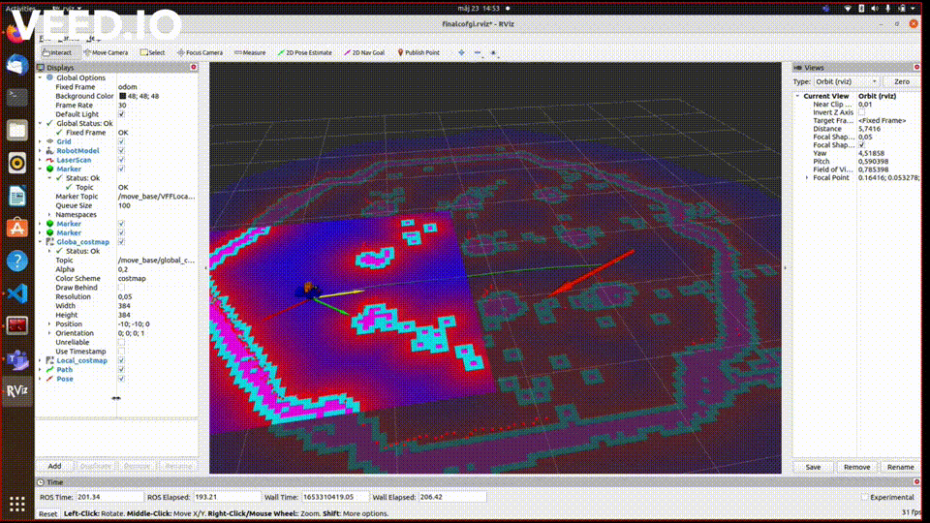
VIRTUAL FORCE FIELD ALGORITHM (VFF)
Video Demonstration

Slide 30
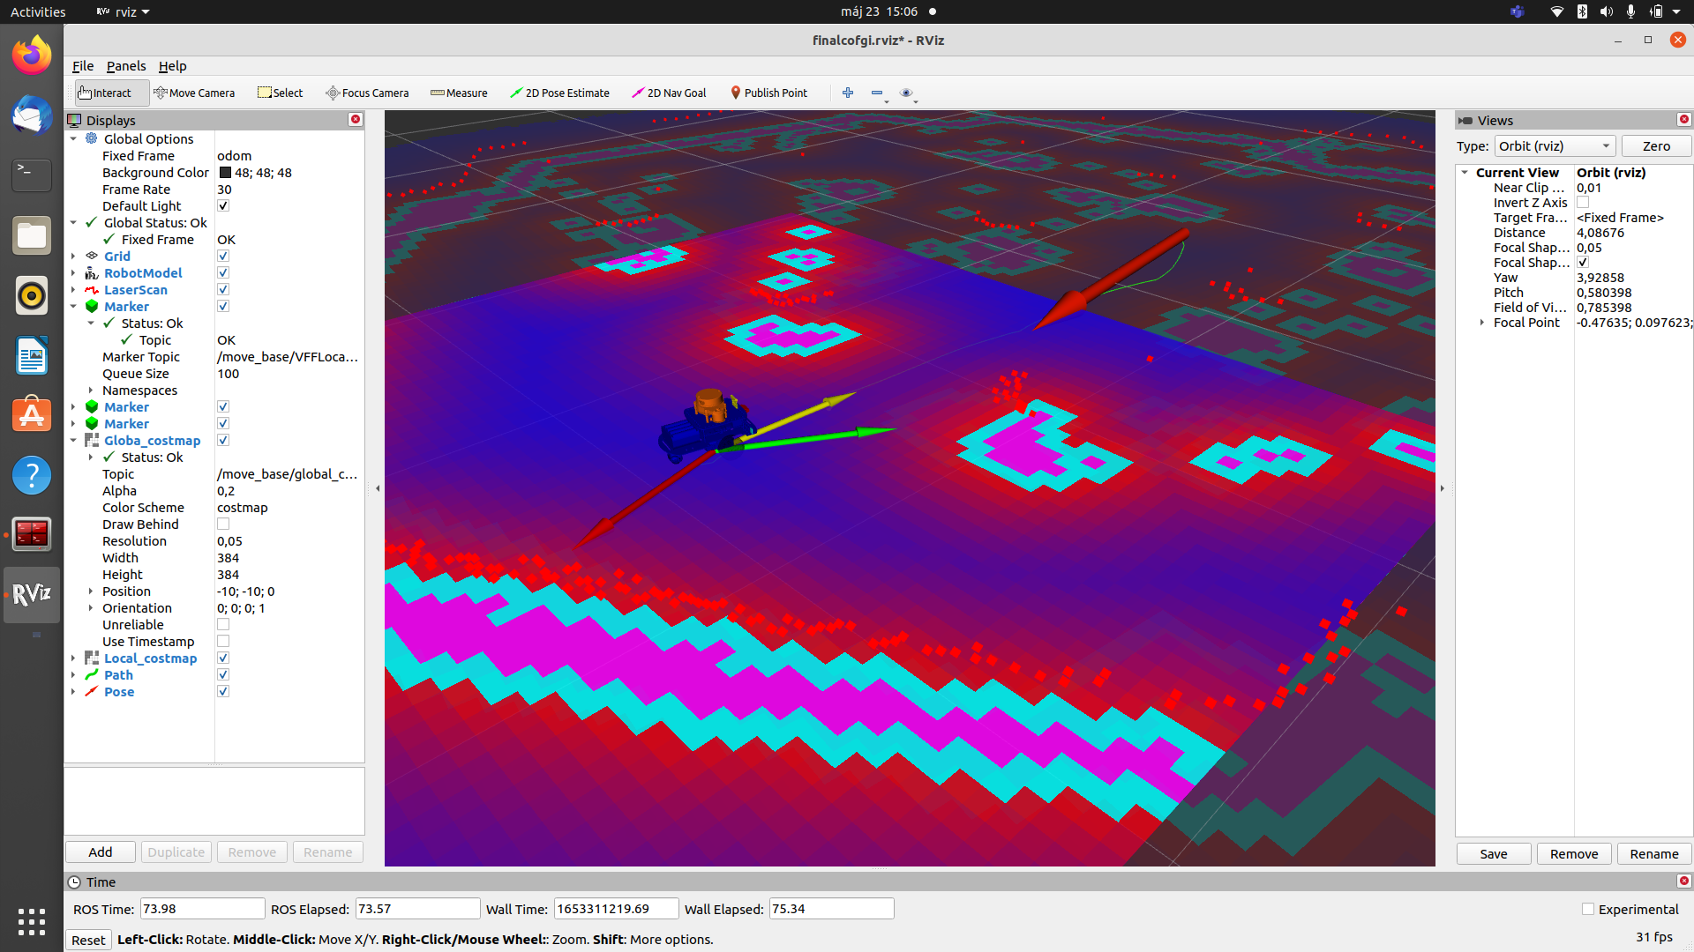
VIRTUAL FORCE FIELD ALGORITHM (VFF)
USE OF MARKER TO INDICATE VIRTUAL FORCES

Slide 31
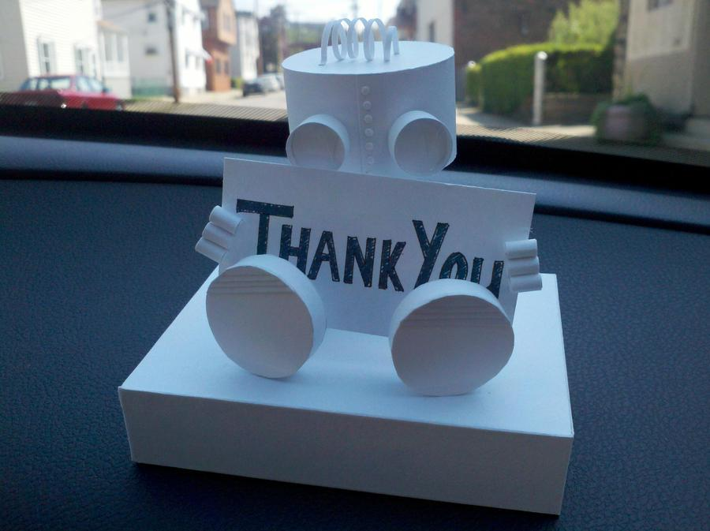

Slide 32


